Slide 1
Breast Cancer Wisconsin (Diagnostic)
Prediction and Model Performance
FAVOUR KPOKPE
JAN 2025

Slide 2
Contents
Introduction
Objective
Data Overview
Exploratory Data Analysis
Data Preprocessing
Model Development
Evaluation Metrics
Hyper-parameter Tuning and Cross-Validation
Model Visualization and Reporting

Slide 3
Introduction
Breast cancer remains a significant global health challenge. Early and accurate diagnosis is essential for improving survival rates and reducing treatment costs. This project aims to classify tumors as malignant or benign using machine learning, focusing on reducing false negatives to ensure timely medical interventions.
The dataset used in this project contains clinical features recorded during tumor assessments, such as radius, texture, perimeter, and area. Each sample is labeled as malignant (1) or benign (0), representing the target variable.

Slide 4
Objective
Develop a classification model to predict tumor types (malignant or benign) based on the given dataset.
Evaluate the model using appropriate metrics (confusion matrix, recall, precision, F1-score, etc.) to minimize false negatives.

Slide 5
Data Overview
Dimensionality: The dataset consists of ( 569 ) rows (samples) and ( 11 ) columns (features + target variable) before preprocessing.
Features: Clinical measurements ('radius', 'texture', 'perimeter', 'area', 'smoothness', 'compactness', 'concavity', 'concavepoints', 'symmetry', 'fractaldimension', and 'Diagnosis' etc.) recorded in triplicate for each sample.

Slide 6
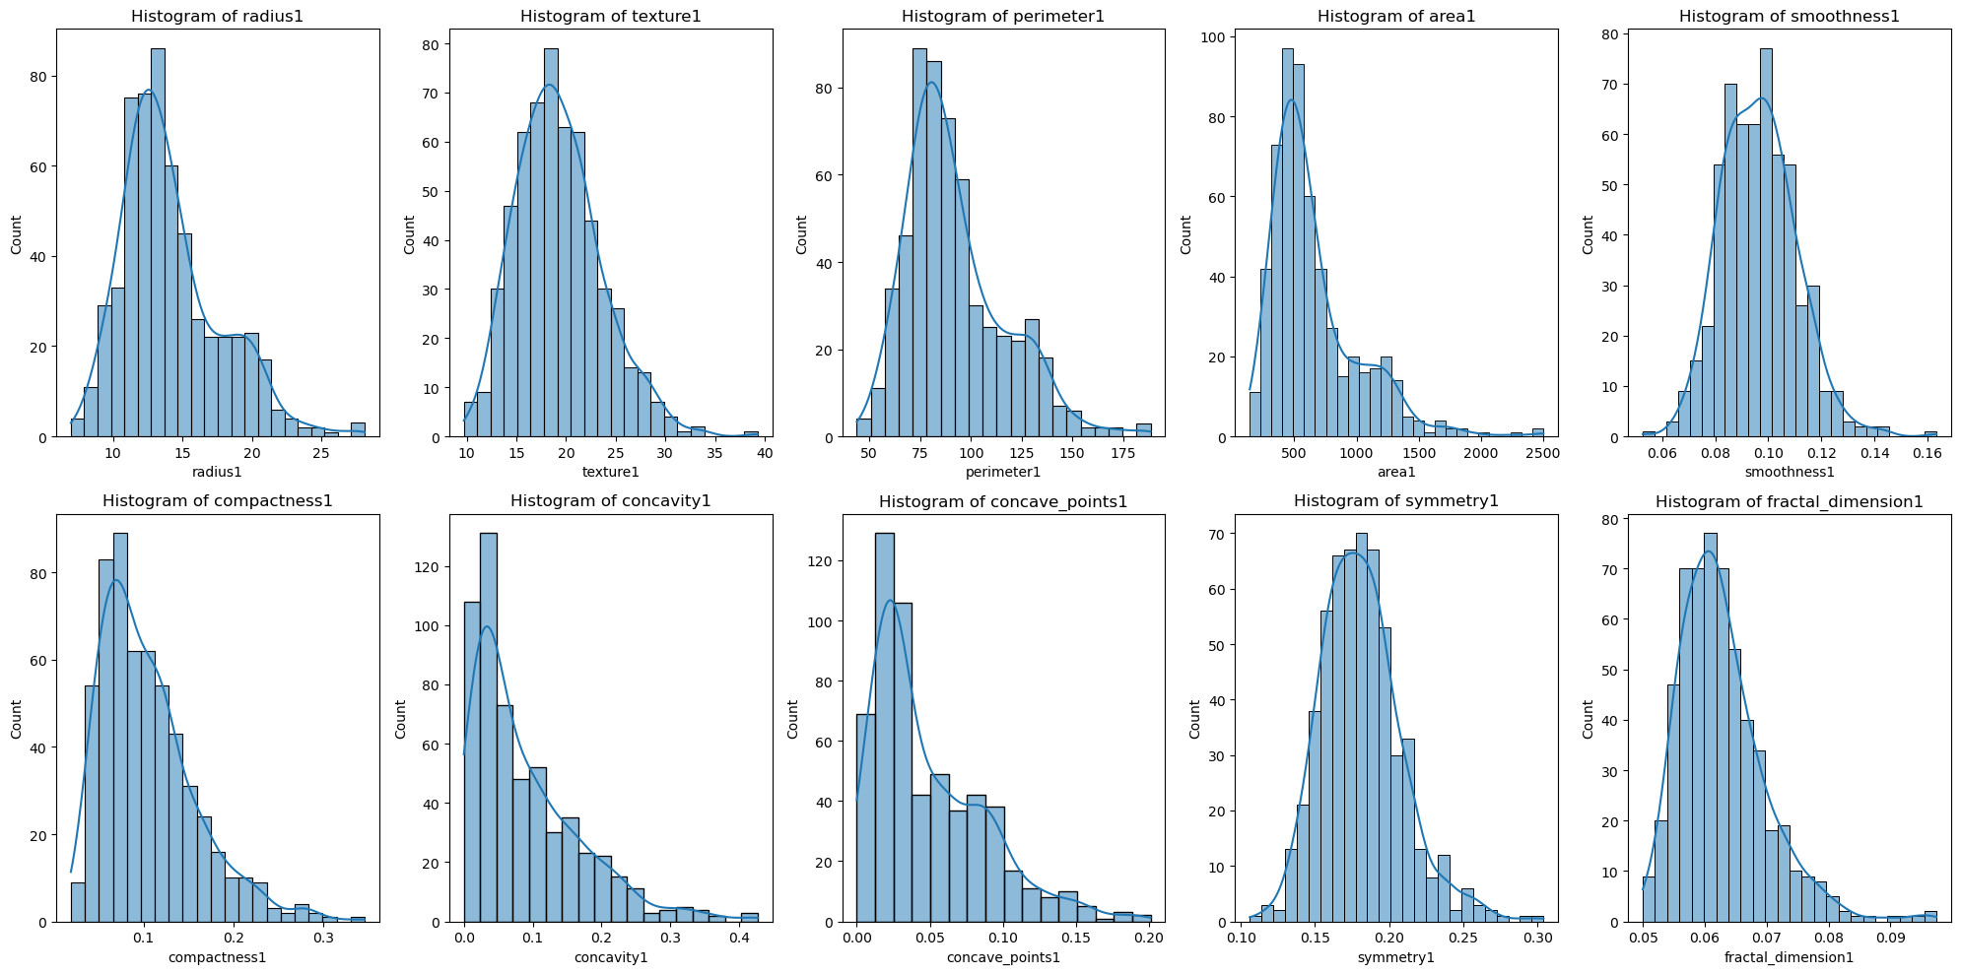
Exploratory Data Analysis Feature Distribution
Histograms for Features

Slide 7
Exploratory Data Analysis Feature Distribution cont’d
Insights from the histplot
Normal Distribution: Many features (e.g., smoothness1, symmetry1) exhibit approximately normal distribution.
Right-Skewed Features: Features like area1 and compactness1 show right skewness, indicating larger values are less frequent.

Slide 8
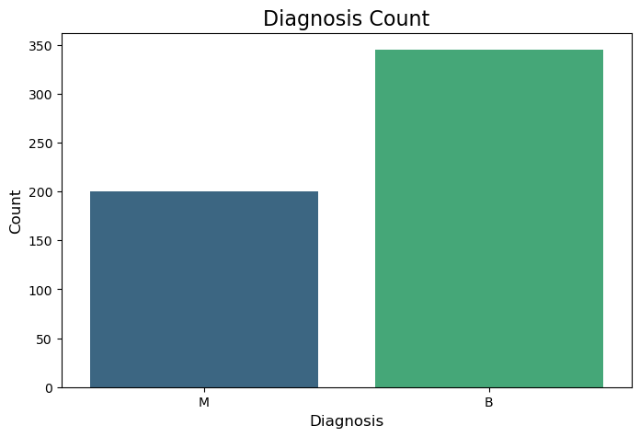
Exploratory Data Analysis cont’d
The dataset shows class imbalance, which necessitated balancing techniques to ensure fair model training

Slide 9
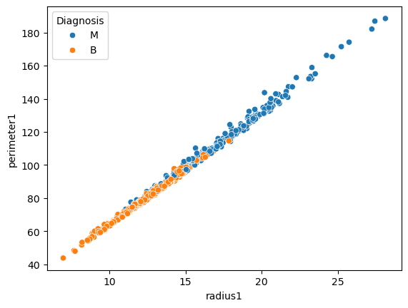
Exploratory Data Analysis cont’d
This scatterplot shows a strong linear relationship between "radius1" and "perimeter1," with data points color-coded by diagnosis: "M" (Malignant) in blue and "B" (Benign) in orange. Malignant cases generally have larger values for both features, indicating these attributes may be useful for classification.

Slide 10
Data Preprocessing
Handled Outliers.
Averaged triplicate features into single features for simplicity.
Applied Label encoding to the target variable(Diagnosis).
Scaled features to normalize the data.
Handled imbalanced data with SMOTE.

Slide 11
Model Development
Algorithms tested: Logistic Regression.
Logistic Regression was chosen for its interpretability and baseline performance. Other models like Support Vector Machine, Random Forest or Gradient Boosting could also be explored.

Slide 12
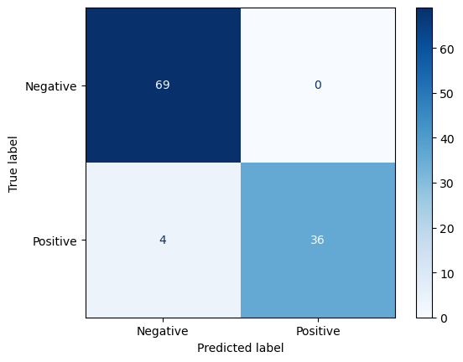
Evaluation Metrics Confusion matrix
True negatives: 69.
False positives: 0.
False negatives: 4.
True positives: 36.

Slide 13
Evaluation Metrics Classification Report
Accuracy: The model correctly classified 96.33% of samples (0.9633).
Class 0 (Benign):
Precision: 0.95 (95% of predicted benign samples are correct).
Recall: 1.00 (100% of actual benign samples are identified).
F1-Score: 0.97 (harmonic mean of precision and recall).
Support: 69 samples.
Class 1 (Malignant):
Precision: 1.00 (100% of predicted malignant samples are correct).
Recall: 0.90 (90% of actual malignant samples are identified).
F1-Score: 0.95. A high F1-score, like 0.95, indicates that the model achieves an excellent balance between precision and recall
Support: 40 samples.

Slide 14
Hyper-parameter Tuning and Cross-Validation
Hyper-parameters were tuned using grid search and randomized search.
After carrying out hyper-parameter tuning using GridSearch and RandomSearch, it was observed that the evaluation metrics remain the same.
This might indicates that the model is likely well-optimized with its current hyper-parameters, and further tuning using GridSearch and RandomSearch did not improve its performance.

Slide 15
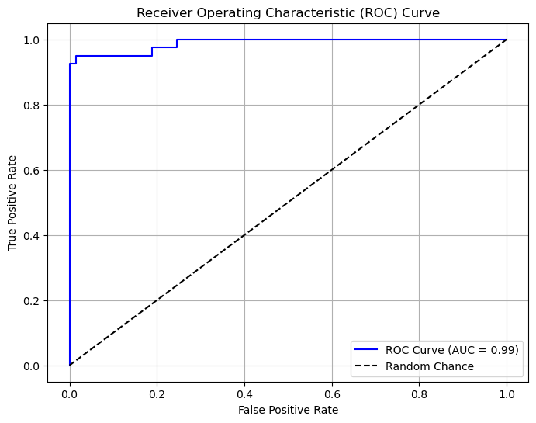
Model Visualization and Reporting
Blue Curve: Represents the model's performance.
The closer it is to the top-left corner, the better the model distinguishes between classes.
Dashed Line: Represents random chance (AUC = 0.5). The ROC analysis reveals that the model performs better than random guessing as the curve is substantially above the dashline.

Slide 16
AUC (Area Under Curve) = 0.99: Indicates excellent model performance, as it’s very close to 1.0, suggesting high true positive rates with low false positives.
Summary: The model is highly effective in classification with minimal misclassifications.

Slide 17
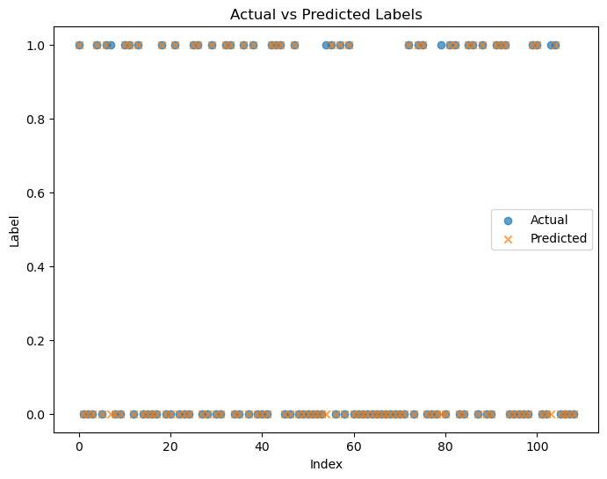
Model Visualization and Reporting

Slide 18
The plot compares the actual labels (blue dots) with the predicted labels (orange crosses) for a binary classification problem.
The X-axis (Index) represents the index of data points in the test dataset.
The Y-axis (Label) represents the binary classes: 0 and 1.
Overlap of Points: The blue dots and orange crosses overlap closely, indicating the model's predictions align well with the actual labels for most data points.
Misclassifications: The orange crosses that don't overlap with blue dots represent incorrect predictions. Though there appear to be very few of these, indicating good model performance.
The plot visually confirms that the model predicts accurately in most cases.

Slide 19
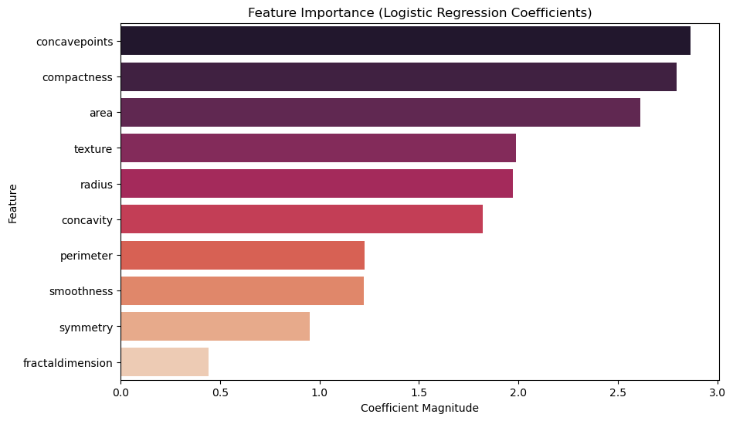
Feature Importance
The bar chart displays the feature importance based on the absolute values of logistic regression coefficients. Features like "concavepoints," "compactness," and "area" are the most influential in predicting the target variable, while "fractal dimension" has the least impact.

Slide 20
Conclusion & Future Work
Summary of Achievements
Achieved 96% accuracy and high 90% recall for malignant cases.
Successfully balanced the dataset and reduced false positives to zero.
Future Research Directions
Explore advanced models (e.g., Random Forest, XGBoost).
Perform feature selection to reduce redundancy.
Tune hyperparameters to optimize model performance further.
Incorporate additional datasets to improve generalizability.
Develop a pipeline for real-time diagnosis in clinical settings.
Explore deep learning methods for feature extraction and classification.

